Slide 1
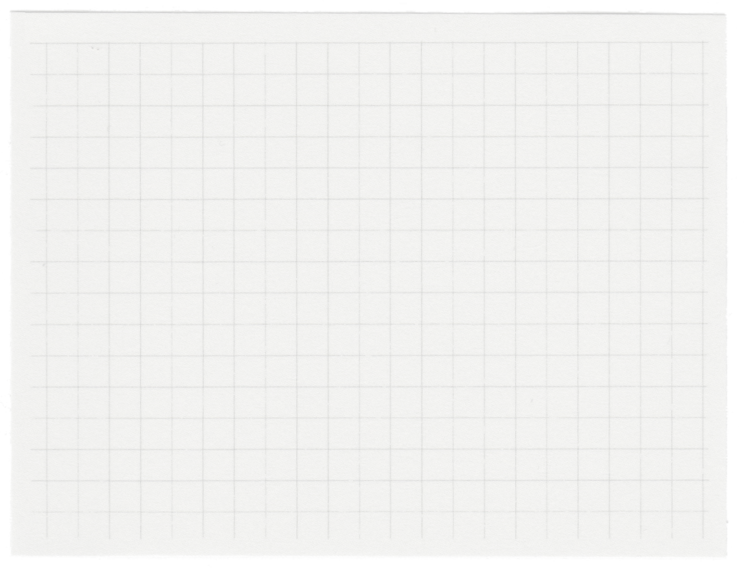

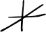
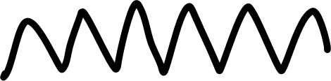
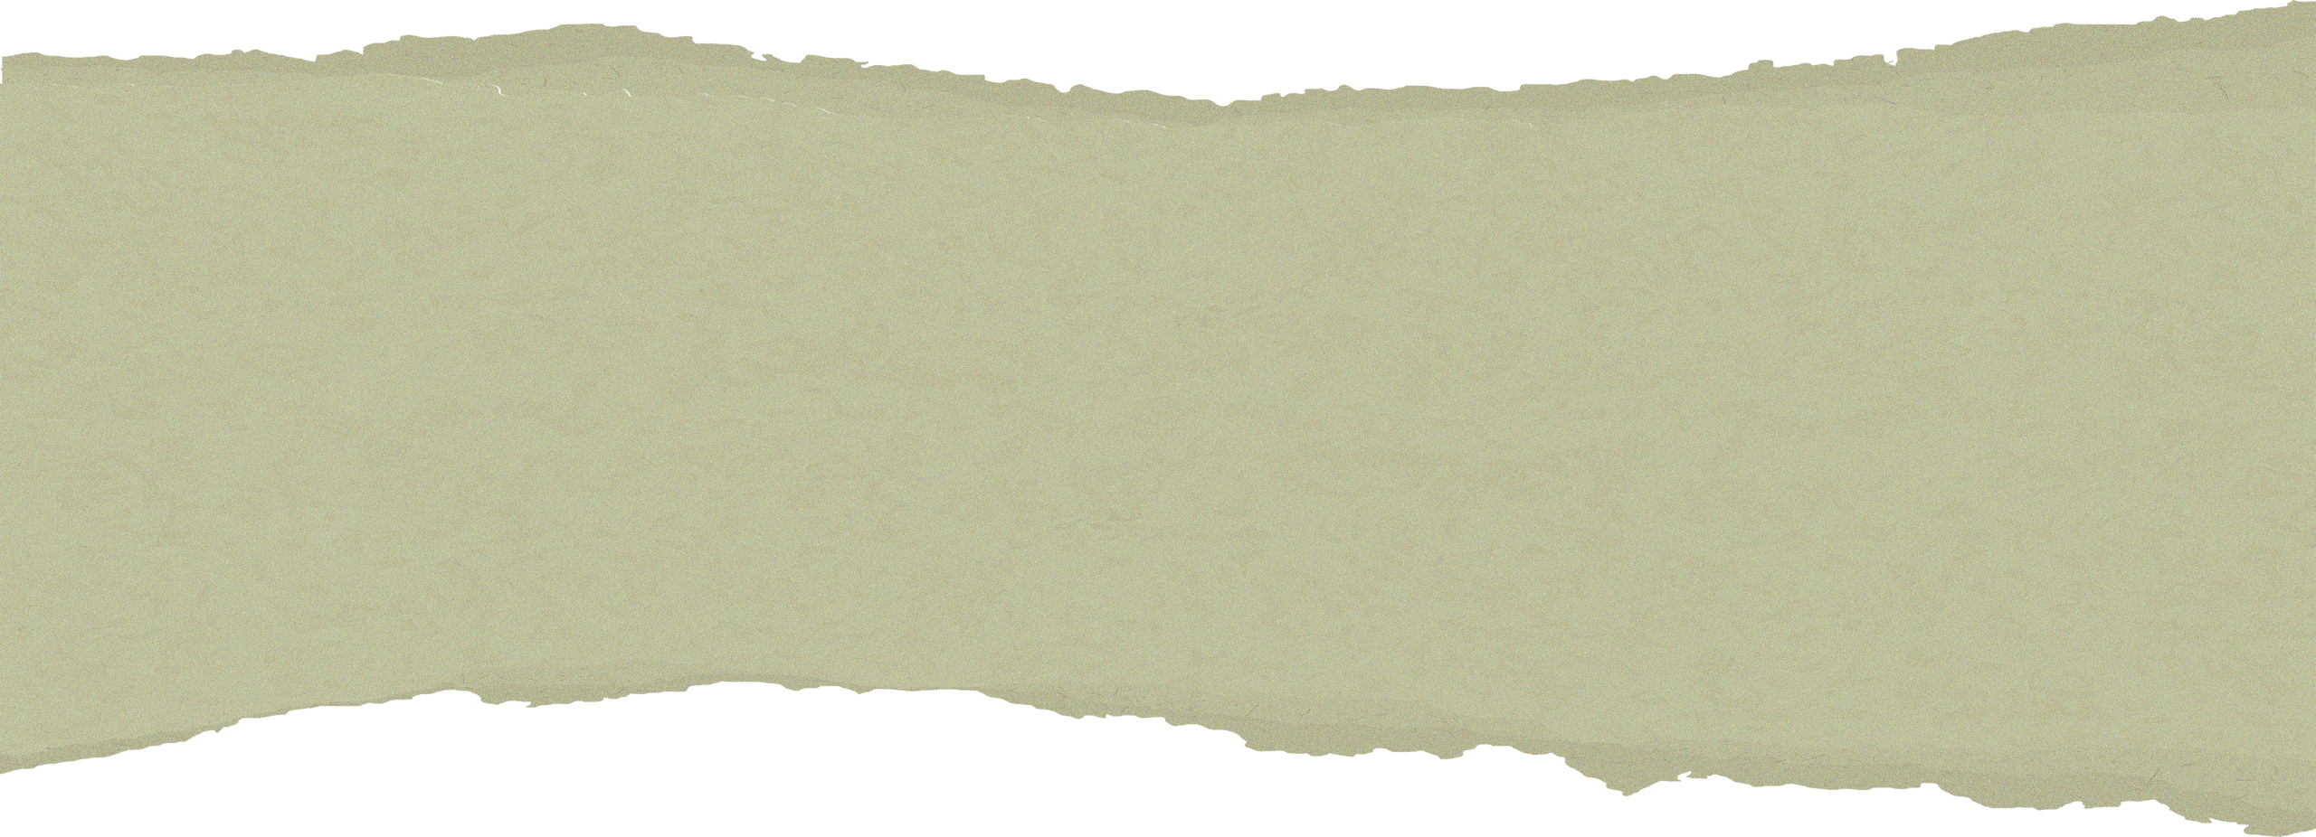


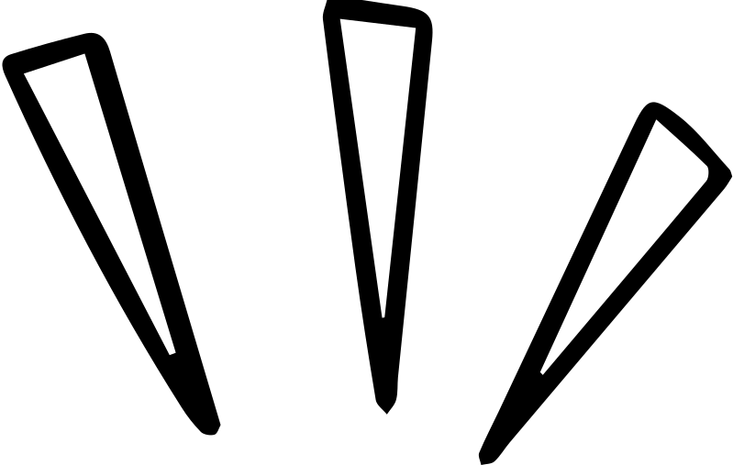





JQuery MCQs
By Riya SIngh

Slide 2

What is it?
jQuery is a JavaScript library designed to simplify how you interact with HTML documents, or more precisely the Document Object Model (DOM).
It makes it easier to find, select and manipulate elements with specific properties.
It also simplifies event handling, CSS animation, and Ajax.
jQuery is a small, fast, and cross-platform library. It's supported by thousands of user-created plug-ins.
It was created & developed by John Resig in 2006

Slide 3
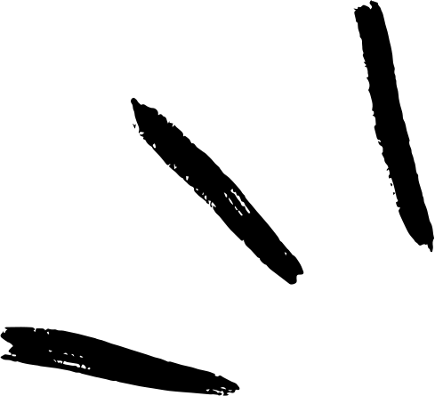

MCQS
1) Which of the following sign is used as a shortcut for jQuery?
a) the % sign
b) the & sign
c) the $ sign
d) the @ sign

Slide 4

Answer: (c) the $ sign
Explanation: Every jQuery selector start with this dollar sign $(). This sign is known as the factory function. It uses the three basic building blocks while selecting an element in a given document.

Slide 5
2) $(this) in jQuery is used when -
a
an HTML element references the entire document
c
an HTML element references the action of its parent element
b
d
an HTML element references its own action
All of the above

Slide 6

Answer: (b) an HTML element references its own action
Explanation: $(this) and this refers to the same element. But they are used in a different way. When 'this' is wrapped in $(), it becomes the jQuery object, and it is used when an HTML element refers to its own action.

Slide 7
3) Which of the following jQuery method is used to hide the selected elements?
a) The hidden() method
b) The hide() method
c) The visible(false) method
d) The display(none) method

Slide 8

Answer: (b) The hide() method
Explanation: The jQuery hide() method is used to hide the selected elements.

Slide 9
4) Which jQuery method is used to set one or more style properties to the selected element?
a) The html() method
b) The style()
c) The css() method
d) All of the above

Slide 10
Answer: (c) The css() method
Explanation: The jQuery css() method is used to get (return) or set style properties or values for selected elements. It facilitates you to get or set one or more style properties.

Slide 11
5) Which of the following jQuery method is used to attach a handler to an event?
a
c
unbind() method
bind() method
b
d
attach() method
None of the above

Slide 12
Answer: (c) bind() method
Explanation: The jQuery bind() event is used to attach one or more event handlers for selected elements from a set of elements. It specifies a function to run when the event occurs.

Slide 13

6) The jQuery method used to perform an asynchronous HTTP request -
a) jQuery ajaxSetup() method
b) jQuery ajaxSync() method
c) jQuery ajax() method
d) None of the above

Slide 14
Answer: (c) jQuery ajax() method
Explanation: AJAX is an acronym for Asynchronous JavaScript and XML. The ajax() method in jQuery performs an AJAX request. It sends an asynchronous HTTP request to the server.

Slide 15
7)Which of the jQuery function prevents the code from running before the loading of the document finishes?
a)$(document).load()
b)$(document).unload()
c)$(document).ready()
d) $(document).trim()

Slide 16
Answer: (c) $(document).ready()
Explanation: The ready() function in jQuery executes the code only when the DOM (Document object model) is fully loaded. The code inserted between $(document).ready() is executed only when a page is ready for JavaScript code to execute.

Slide 17
8) What does the syntax $("p.para") will select?
The first paragraph element with id = "para"
a
c
The first paragraph element with name = "para"
b
d
The first paragraph element with class = "para"
All paragraph elements with class = "para"

Slide 18
Answer: (d) All paragraph elements with class = "para"
Explanation: In jQuery, the correct syntax for selecting all paragraph elements with class = "para" is - $("p.para").

Slide 19
9) The correct syntax for selecting the first paragraph element with id p1 is -
a) $("p.p1:first")
b) $("p#p1:first")
c) $("p1#p:first")
d) None of the above

Slide 20
Answer:(b) $("p#p1:first")
Explanation: In jQuery, the correct syntax for selecting the first paragraph element with id = "p1" is - $("p#p1:first").

Slide 21
10) The jQuery method used to get all ancestors of the matched set of elements is -
a) parents() method
b) parent() method
c) offsetParent() method
d) None of the above

Slide 22
Answer: (a) parents() method
Explanation: The parents() method in jQuery is used to get all ancestor elements of the given selector. This method traverses upwards from the parent element, all the level up in the DOM tree and returns all ancestors of the selected element.

Slide 23
11) What does the syntax $("div#myDiv .para") will select?
a
c
It will select all elements with class = "para" within the div element with id = "myDiv"
All div elements with class = "para" or with id = "myDiv"
b
It will select all elements with id = "myDiv" within the div element with class = "para"
d
None of the above

Slide 24
Answer: (a) It will select all elements with class = "para" within the div element with id = "myDiv"
Explanation: The jQuery syntax $("div#myDiv .para") will select all elements with class = "para" within the div element with id = "myDiv".

Slide 25
12)The jQuery method used to remove the set of matched elements is -
a) delete() method
b) empty() method
c) remove() method
d) None of the above

Slide 26
Answer: (c) remove() method
Explanation: The jQuery remove() method is used to remove the selected elements out of the DOM. It removes the selected element itself, as well as everything inside it (including all texts and child nodes). This method also removes the data and the events of the selected elements.

Slide 27
13) The jQuery used to find all next sibling elements after the current element is -
b) nextAll() method
a) find() method
c) siblings() method
d) None of the above

Slide 28
Answer: (b) nextAll() method
Explanation: The nextAll() method is used to return all next siblings of the specified selector. This method traverses forwards along with the next siblings of DOM elements. Whereas the siblings() method returns all next and previous siblings of the specified selector.

Slide 29
14)The :even and :odd filters in jQuery are used to -
a
c
determine if the number is odd or even
both (a) & (b)
b
d
determine if the index position of an element is odd or even
None of the above

Slide 30
Answer: (b) determine if the index position of an element is odd or even
Explanation: The :even selector in jQuery is used to select the elements with even index numbers (such as 2, 4, 6, etc.). The index starts at 0. The :odd selector in jQuery is used to select the elements with an odd index number (such as 1, 3, 5, etc.).

Slide 31
15) What is the correct jQuery code for making all div elements 100 pixels high?
a)$("div").height="100"
b) $("div").yPos(100)
c)$("div").height(100)
d) Both b & c

Slide 32
Answer: (c) $("div").height(100)

Slide 33
16) If the names of variables are the same, then which of the following type of variable takes precedence?
a)local variable
b) global variable
c)both (a) & (b)
d) None of the above

Slide 34
Answer: (a) local variable
Explanation: In the function's body, the precedence of the local variable is more than the global variable with the same name. If the name of the function's local variable is the same as the name of the global variable, then the local variable hides the global variable.

Slide 35
17) The correct syntax to set the background color of all h1 elements to yellow in jQuery -
a
c
$("h1").style("background-color","yellow");
$("h1").css("background-color","yellow");
b
d
$("h1").html("background-color","yellow");
$("h1").layout("background-color","yellow");

Slide 36
Answer: (c) $("h1").css("background-color","yellow");
Explanation: In jQuery, using the css() method, we can set the style of an HTML element. The correct syntax for setting the background color to yellow of an h1 element is - $("h1").css("background-color","yellow");

Slide 37
Thank you!
By Riya Singh

